Slide 1
DARTMOUTH CLASS OF 1965
CLASS ANNUAL REPORT
FY 2019

Slide 2
Index
Page
Accomplishments 3-6
Calendar of events 7
Pictures of some of our activities 8 -20
Financial snapshot 21 – 22
Bartlett Tower Society 23
Challenges for 2020 24
Officers 25
Statistics 26
In memorium 27

Slide 3
FY 2019 Review -- Accomplishments
Communications
Calls held in July, November, February and May
Quarterly Class Activity Reports prepared for each call
Class Annual Report issued
6 Class Notes columns published in DAM , with 112 mentions of 70 different Classmates
Class www site updated regularly with quarterly activity reports, annual report, photo galleries, info about reunions, links to obituaries
All classmates invited to all conference calls and meetings
Class leadership
Jim Frank named to Board of Trustees
Hank Amon named to Alum Council, for planned giving officers
Roger Hansen on Alum Council for Class of 1965
Jim Griffiths heading nom comm -- to identify officers for next 5 years

Slide 4
FY 2019 Review -- Accomplishments
Reunions and meetings
4-day October Homecoming mini at Moosilauke Ravine Lodge, Hanover, Pierce’s, Griffiths’
Micro mini reunions (breakfasts) in Hanover
Micro mini reunions (breakfasts) in Venice FL
First micro mini reunion (lunch, co-ed) in Snook Haven FL
First micro minis (lunches) in Lake George
First micro minis (lunches) in NYC
Micro mini at spring training game in FL
Class meeting at Pierce’s in Etna in October
Included Class of 1964 in the fall mini and Hanover breakfasts
Planning meeting at Webster’s in July

Slide 5
FY 2019 Review -- Accomplishments (ctd)
Financial
Cash balance exceeded $70k
Supported seven programs: first-year trips; Native American; Baker Library; athletic trips; 1965 Bunkhouse winter trips. Bryan Walsh memorial, College 250th Anniversary Book
DCF –
$396k raised in D Fund program, better than goal of $350k
209 cash and pledge donors, vs target of 269
Generated modest cash by selling Passion for Snow-DVD and Passion for Skiing -- Book
Making progress on BTS target for 2020

Slide 6
FY 2019 Review -- Accomplishments (ctd)
Projects
Stu Keiller and MG working to define project for 55th reunion
Other
Continued Land’s End logo program
Significant volunteering in the Upper Valley -- 5 College Book sale, Winter Carnival snow sculpture, information booth, town gov’t, Hanover Pond Party
All reports filed on time – tax returns, CAR, College financial report

Slide 7
FY 2019 Review -- Calendar of Events
FY 2019
July 17 Planning meeting and conference call
August 7 Lake George micro mini
September 21 - 22 COW
October 11-14 Hanover Fall mini and Class meeting
November 15 - 17 Alumni Council
November 20 Class activity report / conference call
February 20 Class activity report / conference call
March 15 Spring training game – Tigers/Rays – Port Charlotte FL
May 16 Class activity report / conference call
May 16-18 Alumni Council
LOCAL MEETINGS Hanover, NYC, Lake George, Venice FL, Snook Haven FL
HANOVER VOLUNTEERING Information booth on the Green, Winter Carnival Statue; Hanover Pond Party, 5 College Book Sale, Hanover D Club, Hanover FinComm

Slide 8
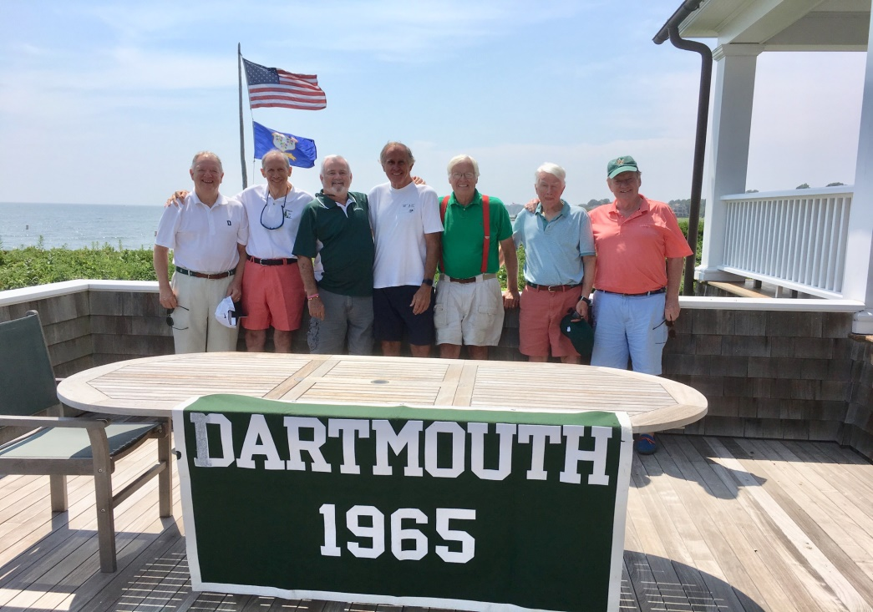
Planning meeting at Bill Webster’s – July 2018
Wittreich, Amon, Orr, Webster, Griffiths, Gonnerman, Boe

Slide 9
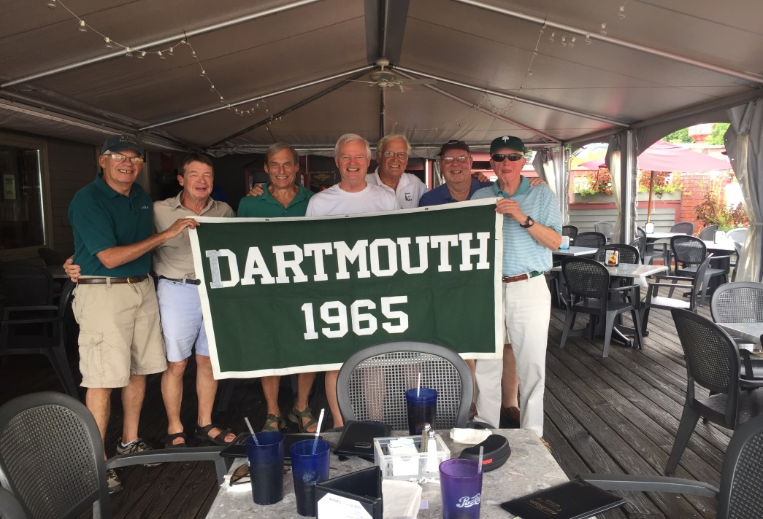
First Lake George luncheon – August 2018
Chuck Cumming, Walter Harrison, Rick Leach, Bob Murphy, Jim Griffiths, Mike Woodbury, MG

Slide 10
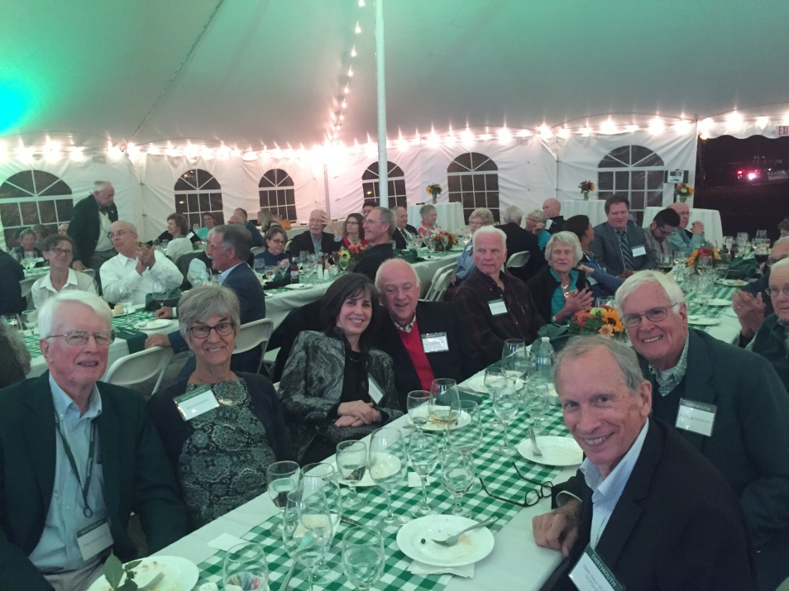
COW – September 2018
INSERT PHOTO
Mike and Betsy G, Barbara and Joel Sternman, Hank Amon, Jim Griffiths

Slide 11
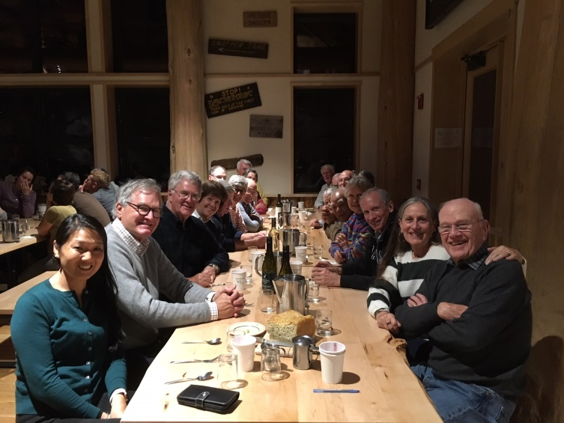
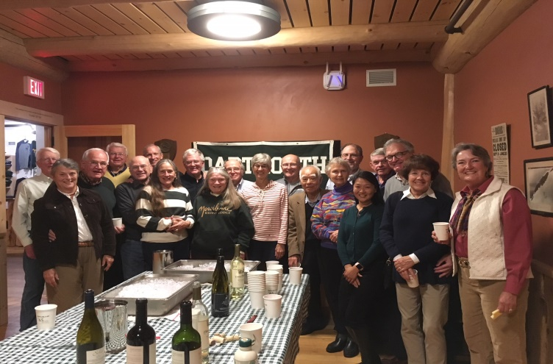
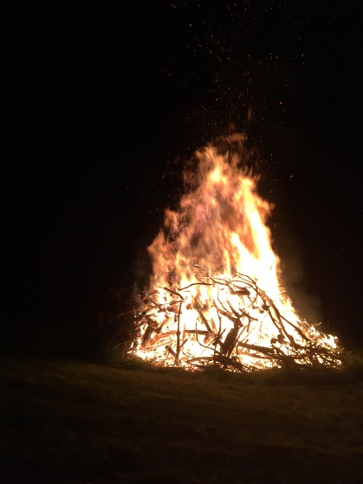
Fall Mini – October 2018

Slide 12
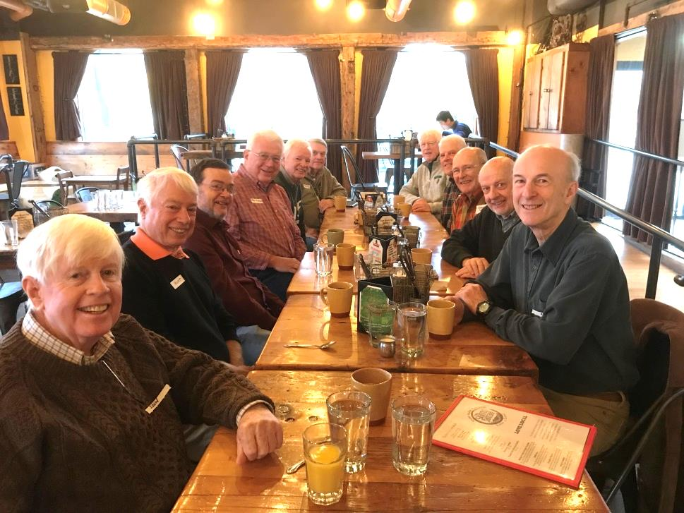
Hanover Breakfast November 2018
Shevlin, Whitacre ‘64, Sheingorn, Frederick, Murphy, Duffy, Gonnerman, Ward ‘64. Hansen, McGeachie, Schaefer ‘64

Slide 13
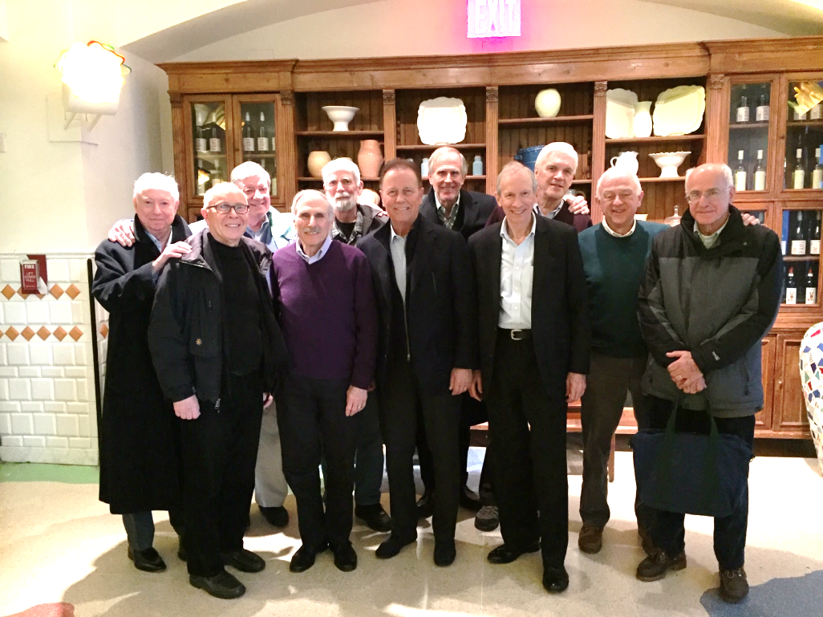
NYC Luncheon December 2018
Charlie Strauss, Brian Porzak, Carl Boe, Jon Silbert, Shep Curtis, Tucky Mays, Bill Webster, Hank Amon, Mike Rodgers, Joel Sternman and Jim Gerson.

Slide 14
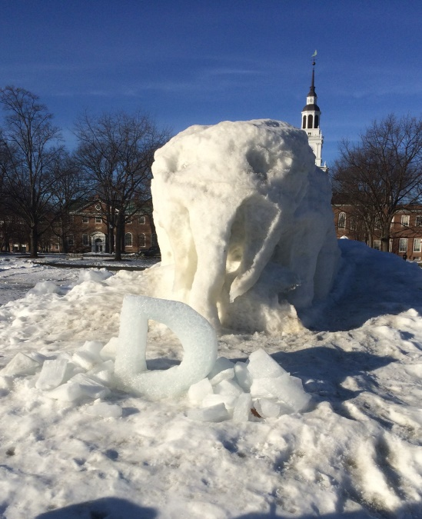
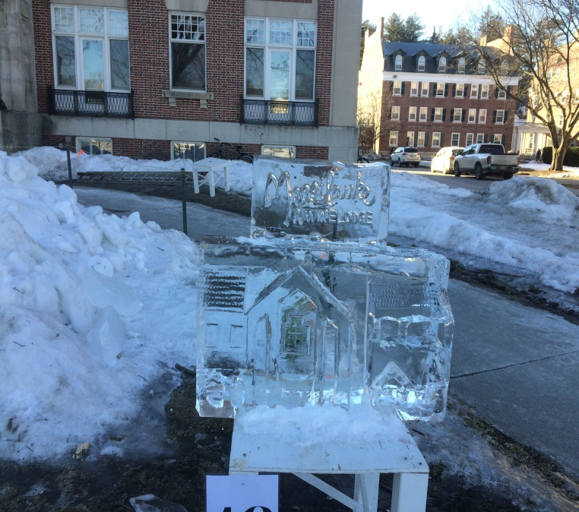
Winter Carnival Snow Statues February 2019
Pete Frederick, Bill Young and MG involved

Slide 15
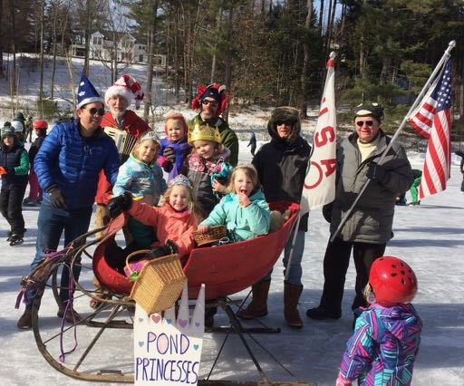
Winter Carnival Pond Party February 2019
Local, community event
1,000+ participants on Sunday after WC
Bill Young organizes. Peter F and MG volunteered

Slide 16
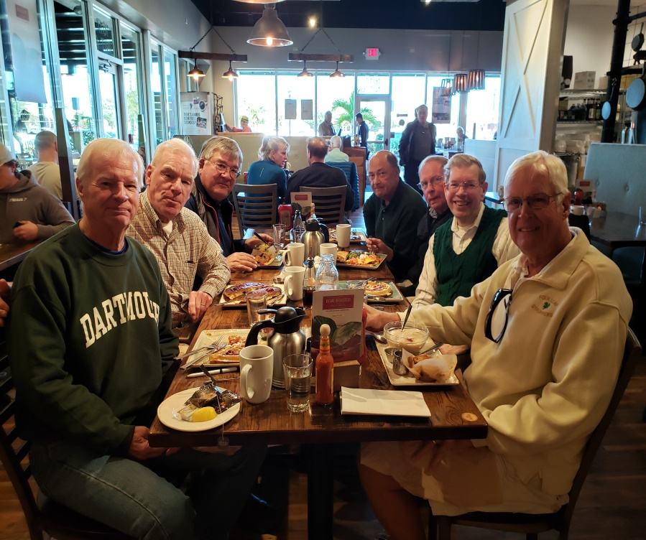
Florida Breakfast March 2019
First Watch Restaurant, Venice
Bob Murphy, Rick Mahoney, Dave Bush, Steve Horvath, Bob Ziemian, Mike Zare, and Jim Griffiths

Slide 17
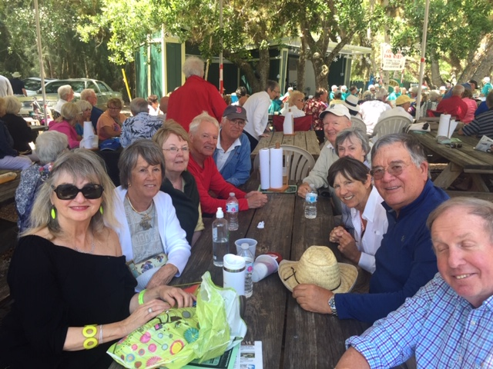
Florida Luncheon March 2019
Snook Haven FL – banjo fest
Carol Ziemian, Deb Griffiths, Brigid and Bob Murphy, Jim Griffiths, George and Jane Wittreich, Laura and Bob Bush, Bob Ziemian

Slide 18
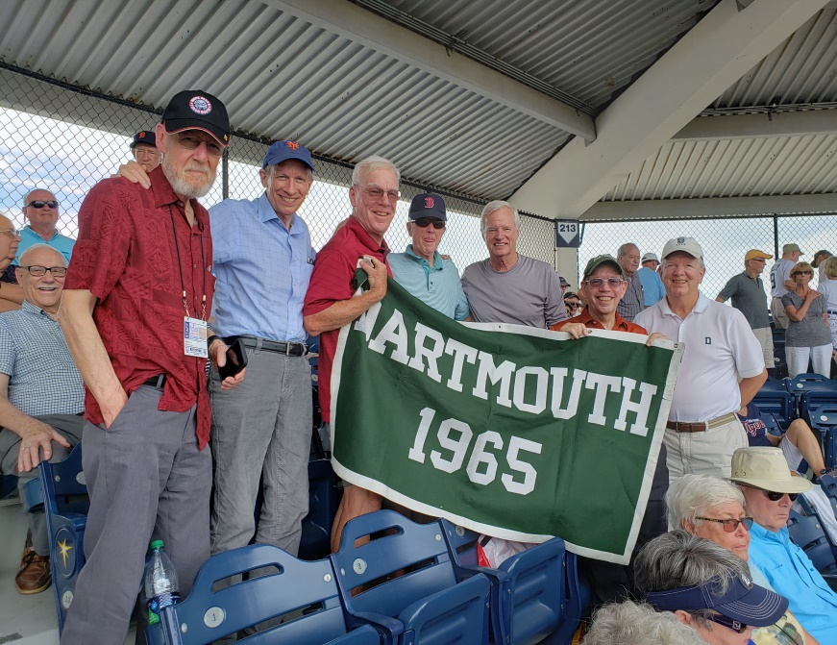
Florida Spring Training Game March 2019
Left to right – Bill Brown, Hank Amon, Rick Mahoney, MG, Bob Murphy, Mike Zare, George Wittreich
Blue Jays vs. Detroit Tigers, Rays Spring Training Center, Port Charlotte
Great seats, in the shade – thank you, Bill Brown
No Jumbotron this year

Slide 19
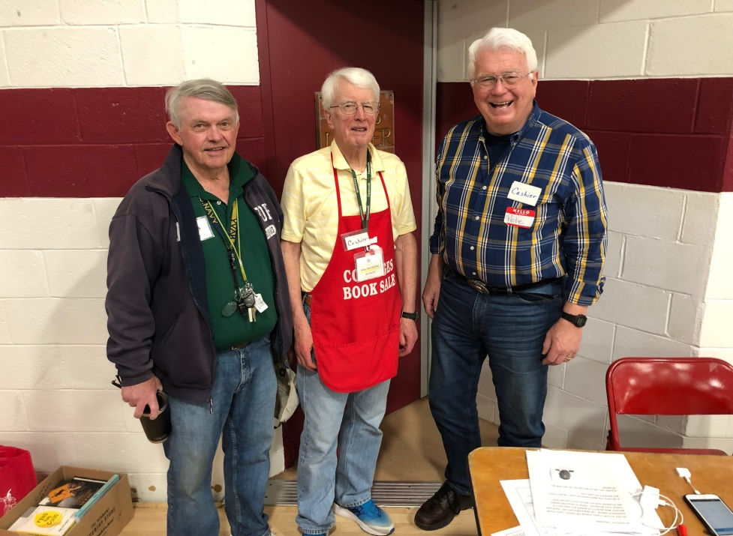
Five College Book Sale April 2019
Larry Duffy, Mike G and Peter Frederick
Proceeds provide scholarship funding to NH or VT students at Mt. Holyoke, Simmons, Smith, Vassar and Wellesley

Slide 20
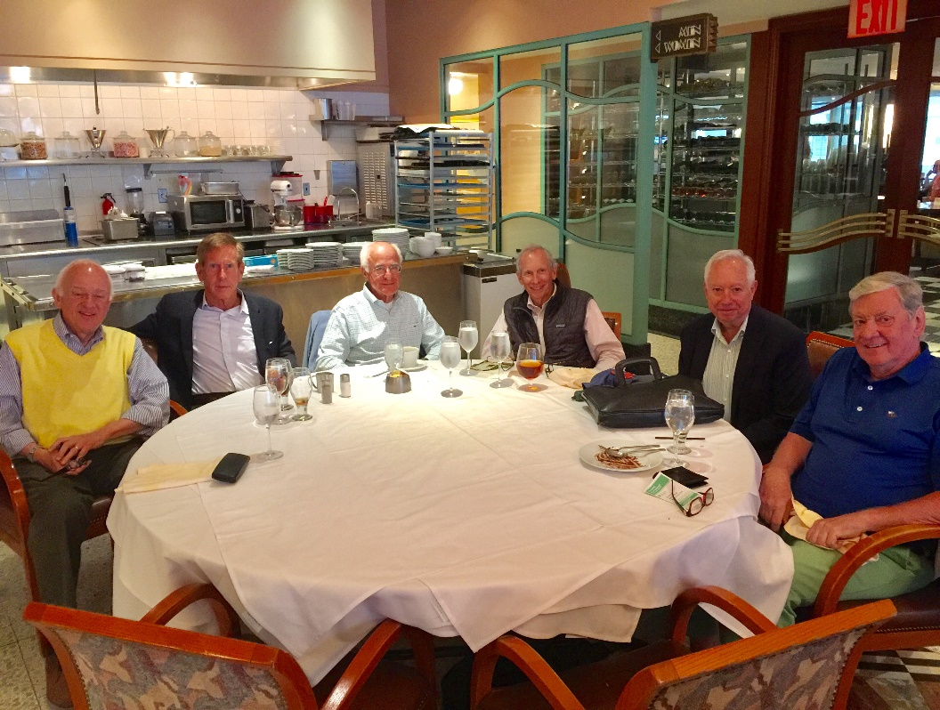
NYC Luncheon June 2019
Joel Sternman, Duncan Burke, Jim Gerson, Hank Amon, Charlie Strauss, Carl Boe

Slide 21
Financial -- Cash Balance ($ Thousands)

Slide 22
Financial -- Cash Flow ($ Thousands)
 |  | FY 2019
Collections | Dues (229 classmates) | 16
 | Contributions | 2
 | Mini fees | 2
 |  | 20
Expenses | Contributions | (9)
 | Mini | (3)
 | Other | (5)
 |  | (17)
Cash flow |  | 3
Beginning balance | June 30, 2018 | 71
Ending balance | June 30, 2019 | 74

Slide 23
Bartlett Tower Society

Slide 24
FY 2018 Challenges for 2020
Prepare for 55th reunion!!!
Put new officer team in place

Slide 25
Officers
President – Mike Gonnerman
Vice President – Roger Hansen
Treasurer – George Wittreich
Secretary / Alumni Column – John Rogers
Dartmouth College Fund Head Agent – Don Bradley
Planned Giving (Bartlett Tower Society) – Hank Amon/Bill Webster
Scholarship Fund – Hank Amon
Alumni Council – Roger Hansen
Webmaster – Stu Keiller
Newsletter Editor – Dick Harris
Mini reunions -- Joel Sternman, Bob Murphy, Bill Brown, Dave Beattie, Stu Keiller, George Wittreich, Jim Griffiths, Mike Gonnerman
Projects: Mt. Moosilauke – Stu Keiller
Monthly breakfast meetings – Bob Murphy, Hank Amon, Joel Sternman
Nominating Committee – Jim Griffiths

Slide 26
Statistics
Class Year: | 1965
# in Original Class: | 817
# Alive as of April 26, 2019: | 666
# Not Interested: | 50
# Lost or "No Good Mail Address": | 16
# "Incapacitated": | 2
Class Base: | 598
# of Surviving Spouses on record: | 52
Dues Base #: | 653
DCF Base #: | 598
Current Class Mail Addressability: | 90.24%
Current Class Email Addressability: | 70.42%

Slide 27
In Memorium – 2018-2019
Robert Gene Busch
Stephen Frederick Hope
Jeffrey Clayton North
George M. Poland, II
Robert Savin Shertz
Edward “Ted” Peary Stafford, Jr.
William Weber Stanton, Jr.
Brian Forrest Walsh

